Slide 1
2024 Recap and Awards

Slide 2
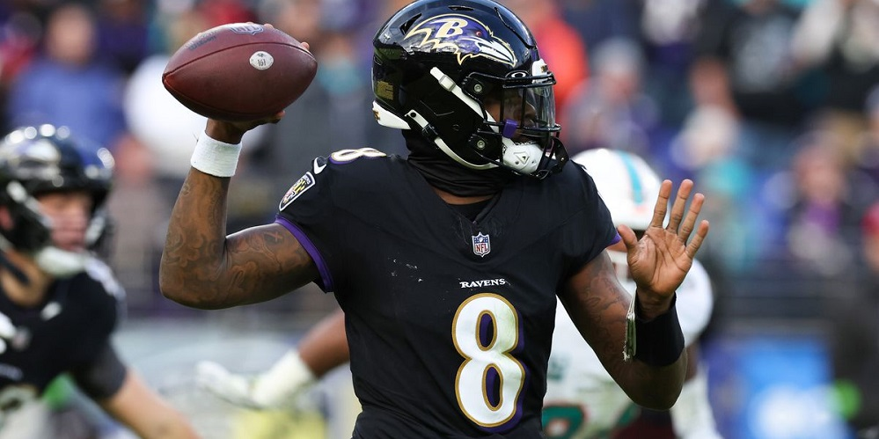
Final Power Rankings – Season Recap

Slide 3
10. Kevin (1-13)
Key moves:
  Selling his entire team
Team Theme:
  No show
    From the draft to the season and now the offseason awards
Looking forward:
  Kevin’s team has the hopes and dreams of draft picks in his future
  Expiring: McLaurin (RFA), Penix, Jayden Reed, Xavier Worthy, JJ McCarthy

Slide 4
9. Neal (5-9)
Key Moves:
  Traded at worst a top 3 pick for Kyle Pitts
  Obtained Jordan Love in RFA
  Took Marvins Harrison Jr. #1 overall
Team theme:
  Underperformance
    See Key moves above
Looking forward:
  Has a second rounder and then nothing until the 6th round this year
  8 remaining years on Jordan Love will make it difficult to obtain RFA’s
  Expiring: Walker III, Jordan Addision, Kyle Pitts (kidding)

Slide 5
8. Eric (7-7)
Key Moves:
  Drafted AJ Brown and Rashee Rice
Team Theme
  Unlucky
    Despite scoring most points until the last week of the season, narrowly missed playoffs and somehow wound up 8th in the standings
Looking forward
  Expiring contracts: Saquon, Drake London, Brece Hall, DK Metcalf
  Has the most lottery balls

Slide 6
7. Skull Raiders (7-7)
Key moves:
  Matching RFA on CJ Stroud
Team Theme:
  Inconsistency
  Stroud led the way - after finishing as a top 10 QB in 2023, Stroud struggled to QB 18
Looking Forward:
  Loses Puka Nacua
  Will have top 5 draft pick
  Needs Stroud to play like 2023 Stroud

Slide 7
6. Adam (8-6)
Key Moves:
  Retained Burrow in RFA
  Drafted Malik Nabers (traded for a haul)
Team Theme:
  Couldn’t finish
  Was a lock for the playoffs until choking his spot away
Looking Forward:
  This will shock you but Adam doesn’t have a first rounder
  Will lose Evans
  Expiring: Tyrone Tracy, Cooper Kupp, Brian Thomas

Slide 8
5. Rob (8-6)
Key Moves:
  Traded a HAUL to obtain Jonathan Taylor
  Picked up Bo Nix
Team Themes:
  Another team that had a playoff spot all but locked up and couldn’t win until it was too late vs Kevin in week 14
  3rd least points scored but 2nd least scored against him
Looking forward:
  Surprisingly does have a 1st rounder!
  Expiring: Bo Nix, Achane, and Pickens

Slide 9
4. Rich (8-6)
Key Moves:
  Caleb Williams and Dak Prescott in 1st round, Joe Mixon in 2nd
  The one year he SHOULD have went heavy on rookie WR’s and he took Adam Thielen
Team Theme:
  Improvement
    Rich’s team went from laughing stock to contender overnight
Looking forward:
  Future looks bright, has 3 more 1st rounders this year and 2 next year
  Expiring: JSN, Mixon, Mark Andrews, Godwin

Slide 10
3. Commish (8-6)
Key moves:
  Sold the winning team after starting 2-6
  Drafted, traded and then traded back for Jayden Daniels
Team Theme:
  Streaky
    Started off 2-6 and then ripped off 6 straight to miss the playoffs
Looking forward:
  Light on picks this year but pick heavy the 3 following years
  Expiring: Chase Brown, Bucky Irving, Tyreek Hill (franchise), Nabers, Jameson Williams

Slide 11
2. Pat (10-4)
Key Moves:
  Traded Gibbs for Jets WR core
  Drafted Baker Mayfield in 3rd round
Team Theme:
  Fraud?
    Had the least points scored against him (300+ less than Eric)
    Scored 5th most points
    Played the 4 seed who scored 85 points to get into champion game where he was drubbed
Looking forward:
  Expiring: Josh Jacobs, Davante Adams (franchise), Sutton, Baker, Jeudy, Diggs
  Has first rounder this year

Slide 12
1. Chris (8-6)
Key Moves:
  Completely remade his roster giving up future first rounders through 2028
  Lamar, Gibbs & Bowers
  Drafted Derrick Henry
Team Theme
  Champion
  Had a scary 3 game losing streak but snuck into playoffs and dominated
Looking forward
  Doesn’t have to scout for the draft anytime soon
  Expiring: Gibbs, Henry, McConkey, Purdy, Montgomery

Slide 13

League History

Slide 14
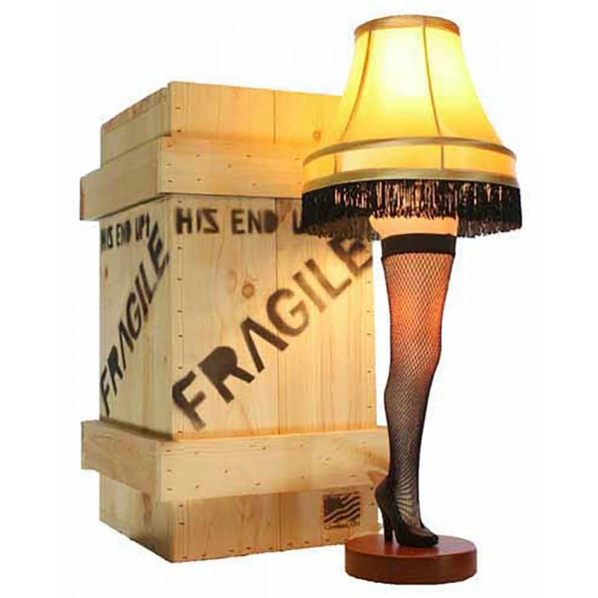
Leg Lamp Champions
2009: Kevin (Bad New Bears)
2010: Pat (Team Pokeher)
2011: Tom (Cleveland Curse)
2012: Pat (Team Pokeher)
2013: Kevin (My Left Nut)
2014: Matt (Team Weigand)
2015: Pat (Team Pokeher)
2016: Chris (Team Baymax)
2017: Tom O’Malley (Cranky Commish)
2018: Tom O’Malley (Cranky Commish)
2019: Tom O’Malley (Cranky Commish)
2020: Tom O’Malley (Cranky Commish)
2021: Carbs (Carb Loading)
2022: Rob (PPR Rulez)
2023: Adam (OU Drinking Team)
2024: Chris (Team Baymax)

Slide 15

Leg Lamp Champions
Titles:
  Tom – 5
  Pat – 3
  Chris - 2
  Kevin – 2
  Matt – 1
  Carbs – 1
  Rob – 1
  Adam - 1
No Titles:
  Dan
  Neal
  Rich
  Eric

Slide 16

Awards

Slide 17
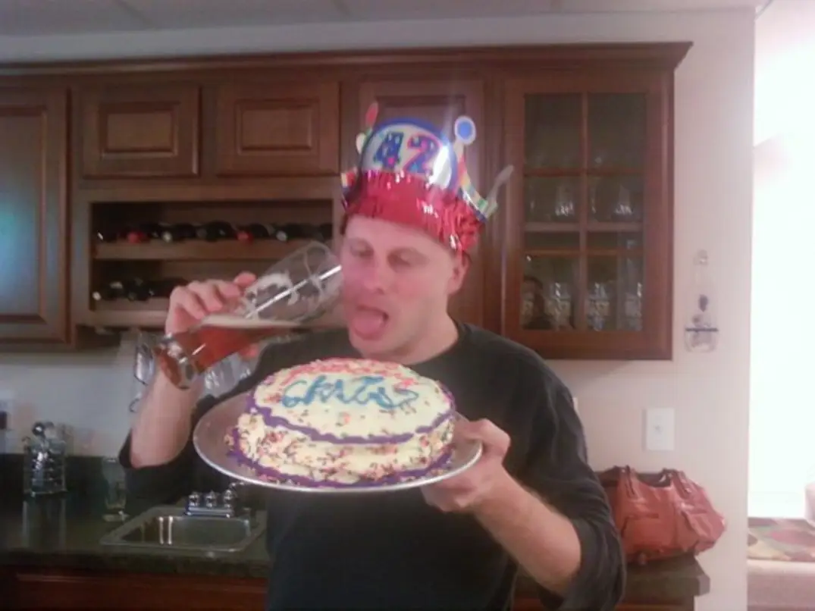

Champion – Chris (Team Baymax)

Slide 18
The Adam Dishong Award (Middler)
Adam Dishong
  He finally popped his cherry last year after years of middling
  He followed up his championship season by finishing 8-6 and narrowly missing the playoffs…in other words…middling

Slide 19
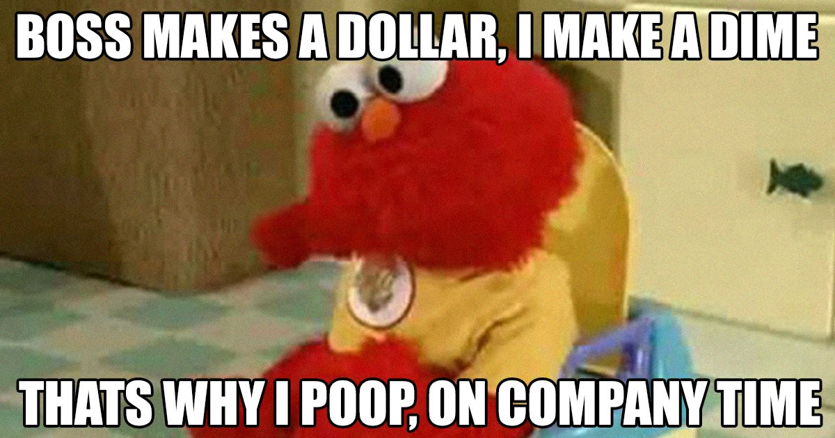
Most Pooped on
Not even doing a runner up, we all know this is Eric
  1933.04 points against
  Next closes team was 1863.58 and that was Kevin so it didn’t even matter

Slide 20
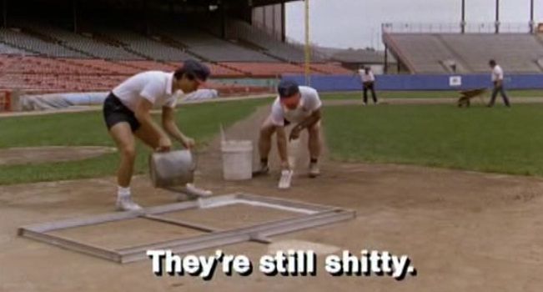
Shittiest
Again, the runner up isn’t even worth mentioning – it’s Kevin
  1404.96 points

Slide 21
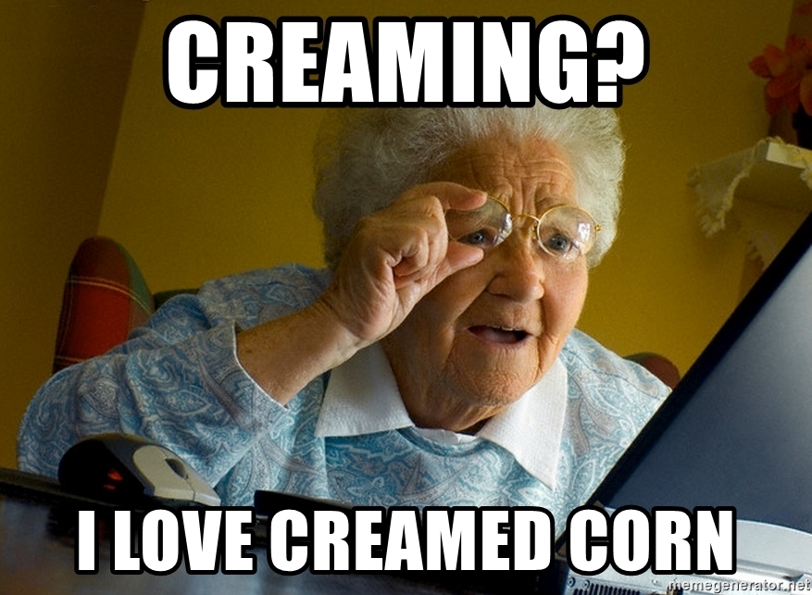
Creamed Corn Award (Cream of the Crop)
Runner Up
  Eric (1912.1 Points)
Winner
  Chris (1962.7 Points) *3rd year in a row!!!

Slide 22
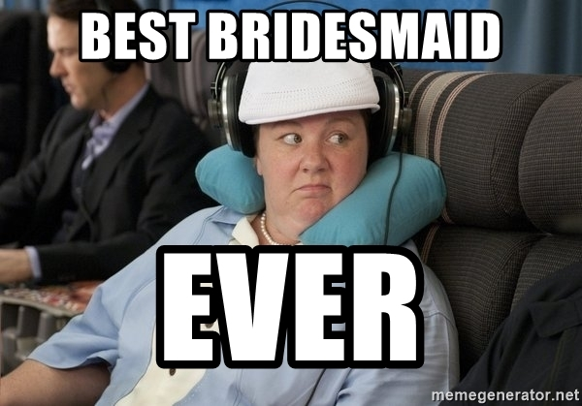
Bridesmaid
Runner up
  Pat – 2nd year in a row
  *Worth noting Chris won this 3 years in a row before winning the championship
Winner
  Eric
  2nd most points (1st most of year) and missed playoffs

Slide 23

White Flag Award
  Runner up
    Tom
    Traded Jackson, Gibbs and Bowers after starting 2-6
  Winner
    Kevin
    Didn’t even show up to the draft before starting fire sale

Slide 24
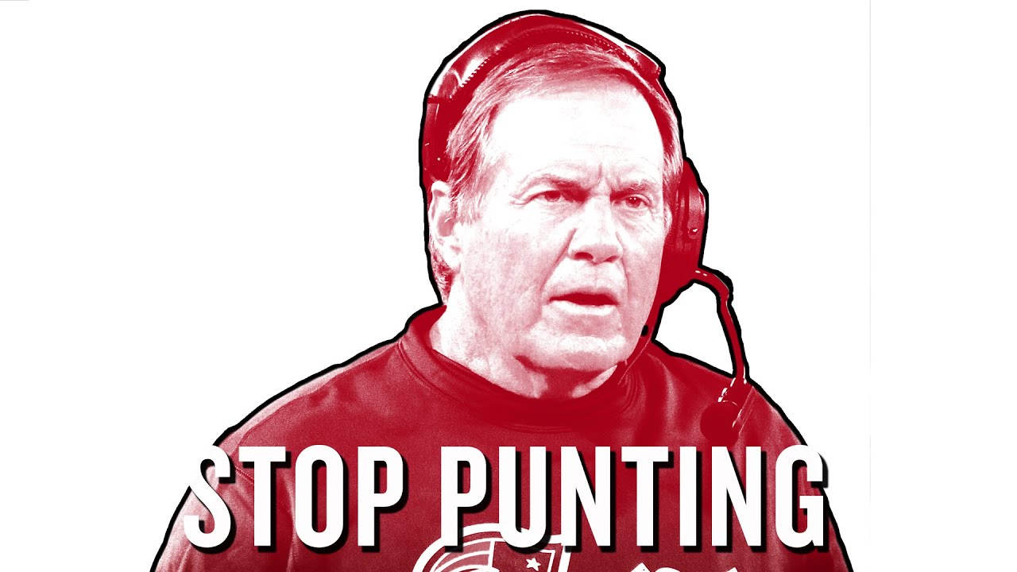
Going for it Award
  Chris
    Traded his first rounders through 2028 to obtain Jackson, Gibbs and Bowers

Slide 25
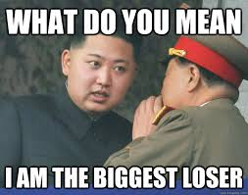
Least Improved
Runner Up: Dan
  2nd biggest wins differential at -3 (10-4 last year with playoffs and 7-7 this year no playoffs)
Winner: Kevin
  His team no showed like he did to the draft

Slide 26
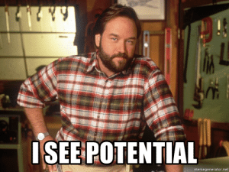
Most Improved
Runner Up: Eric
  Took over a 5-9 team that was second least in points and went 7-7 scoring the second most points narrowly missing the playoffs
Winner: Rich
  He was an easy toilet winner last year and won the division this year!

Slide 27

Best Couple
Chris and Dan
  Dan rooted for Chris very hard thinking his “good luck” texts were genuine

Slide 28

The Tom & Kevin Worst Couple Award
Runner up:
  Neal and Kyle Pitts
2nd Runner up:
  Kevin and vacation
Winner:
  Rob complaining at 2:20pm every Sunday

Slide 29

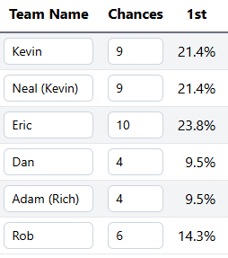
Lotto

Slide 30
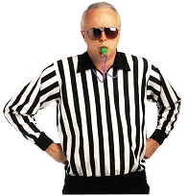
Rules Talk

Slide 31
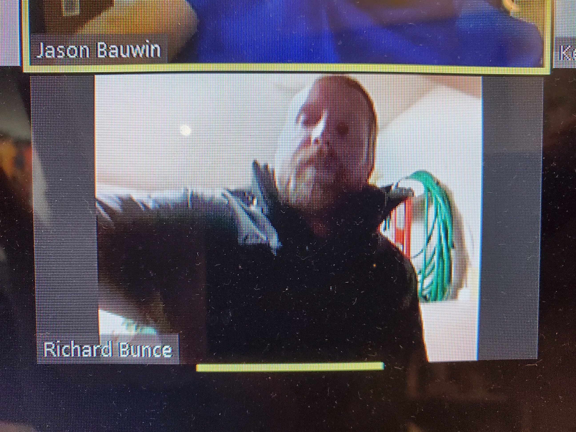
Open Discussion/Rage Quitting

