Slide 1
2023 Recap and Awards

Slide 2

Leg Lamp Champions
2009: Kevin (Bad New Bears)
2010: Pat (Team Pokeher)
2011: Tom (Cleveland Curse)
2012: Pat (Team Pokeher)
2013: Kevin (My Left Nut)
2014: Matt (Team Weigand)
2015: Pat (Team Pokeher)
2016: Chris (Team Baymax)
2017: Tom O’Malley (Cranky Commish)
2018: Tom O’Malley (Cranky Commish)
2019: Tom O’Malley (Cranky Commish)
2020: Tom O’Malley (Cranky Commish)
2021: Carbs (Carb Loading)
2022: Rob (PPR Rulez)
2023: Adam (OU Drinking Team)

Slide 3

Leg Lamp Champions
Titles:
  Tom – 5
  Pat – 3
  Kevin – 2
  Matt – 1
  Chris – 1
  Carbs – 1
  Rob – 1
  Adam - 1
No Titles:
  Dan
  Neal
  Rich
  Eric

Slide 4

Awards

Slide 5

Champion
OU Drinking Team
- Leg Lamp Virgin!

Slide 6
The Adam Dishong Award (Middler)
Chris
  First time this award has been presented to anyone but Adam
  Hung around the playoff picture and may have won it all but couldn’t make the playoffs

Slide 7
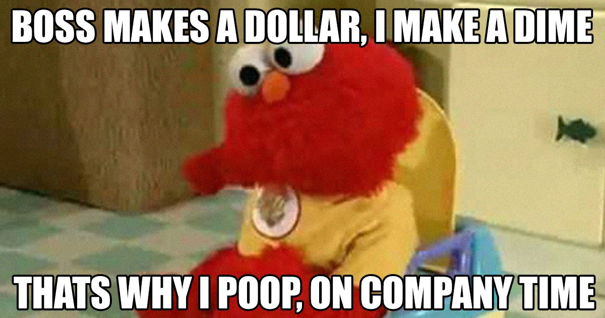
Most Pooped on
Runner Up
  Tom (1810.74 points against)
Winner
  Rob (1865.3 points against)

Slide 8
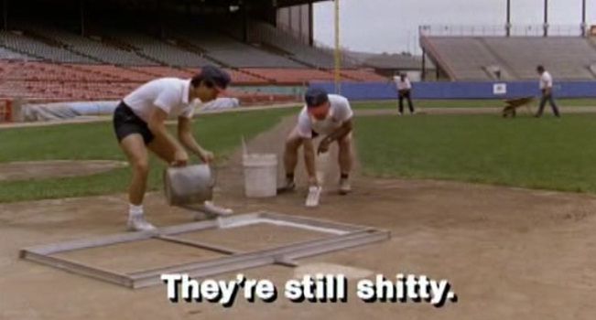
Shittiest
The runner up isn’t even worth mentioning as this was the shittiest performance by 250 point margin – Rich: 1324.48 points

Slide 9
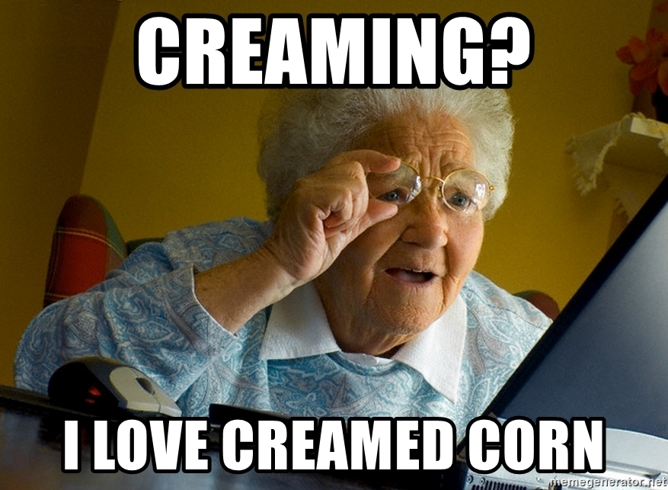
Creamed Corn Award (Cream of the Crop)
Runner Up
  Tom (1970.88 Points)
Winner
  Chris (2014.4 Points) *2nd year in a row

Slide 10

Bridesmaid
Winner
  Chris (3rd year in a row)
  Most points and missed playoffs – would have won it all
Runner up
  Pat – couldn’t quite finish against Adam

Slide 11
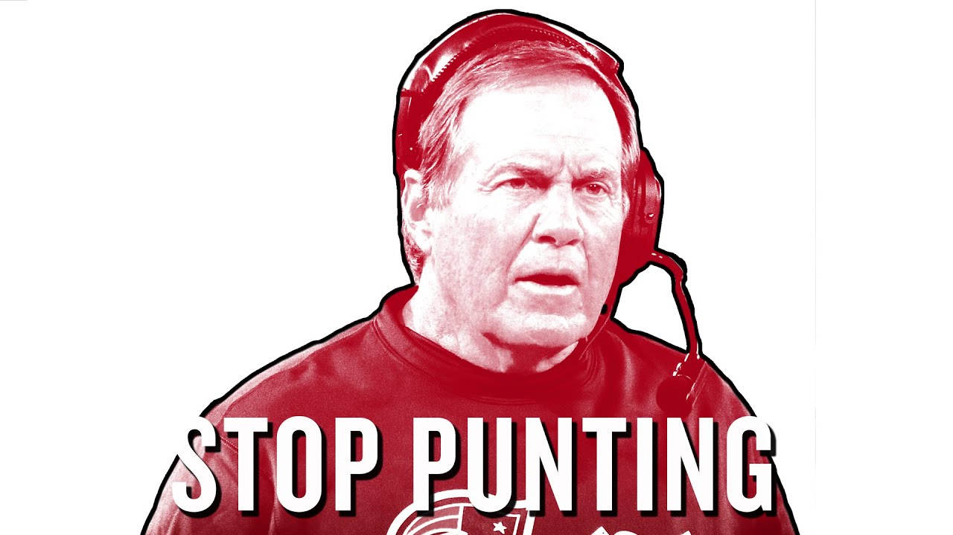
Going for it Award
  Kevin
    It was a pretty quiet trade deadline but Kevin committed 11 years to WR’s in RFA

Slide 12
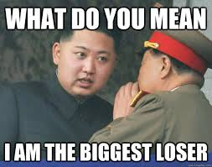
Least Improved
Runner Up: Rob
  Went from league winner to tough luck loser in 2023
Winner: Rich
  His draft included Sam Howell in the first rd and a ton of rookie WR’s and that was the highlight of his year

Slide 13
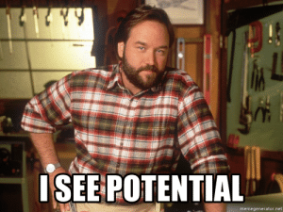
Most Improved
Runner Up: Neal
  He was in playoff contention until the final week of the regular season. This usually happens in week 5
Winner: Dan
  He went from the bottom of the league to the favorite down the stretch. Can he keep his winning ways in 2024?

Slide 14

Best Couple
Rich and Rookie WR’s

Slide 15

Worst Couple
Winner: Rich and Rookie WR’s

Slide 16
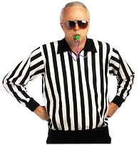
Rules Talk
Kevin proposed players not drafted go to waivers instead of free agency

Slide 17
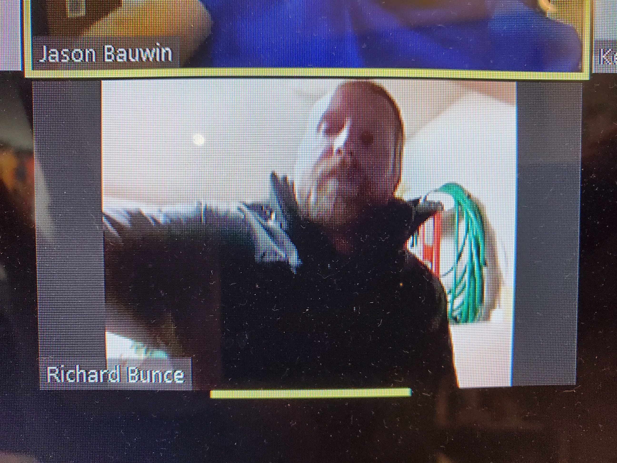
Open Discussion/Rage Quitting

