Slide 1
2022 Recap and Awards
& 2023 Lottery

Slide 2
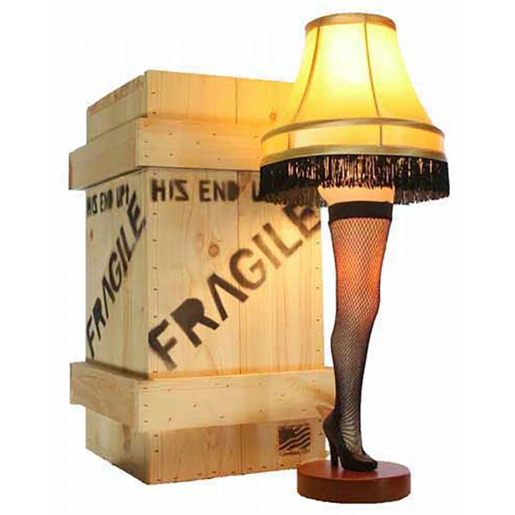
Leg Lamp Champions
2009: Kevin (Bad New Bears)
2010: Pat (Team Pokeher)
2011: Tom (Cleveland Curse)
2012: Pat (Team Pokeher)
2013: Kevin (My Left Nut)
2014: Matt (Team Weigand)
2015: Pat (Team Pokeher)
2016: Chris (Team Baymax)
2017: Tom O’Malley (Cranky Commish)
2018: Tom O’Malley (Cranky Commish)
2019: Tom O’Malley (Cranky Commish)
2020: Tom O’Malley (Cranky Commish)
2021: Carbs (Carb Loading)
2022: Rob (PPR Rulez)

Slide 3

Leg Lamp Champions
Titles:
  Tom – 5
  Pat – 3
  Kevin – 2
  Matt – 1
  Chris – 1
  Carbs – 1
  Rob - 1
No Titles:
  Adam
  Dan
  Neal
  Rich

Slide 4

Awards

Slide 5

Champion
PPR Rulez
- Leg Lamp Virgin!

Slide 6
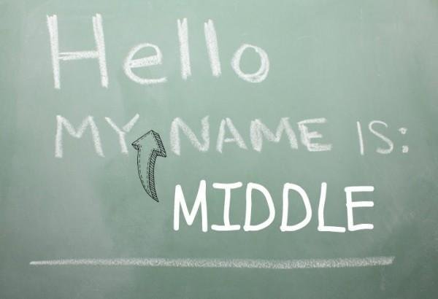
The Adam Dishong Award (Middler)
Adam
  Nothing else to say here
  3rd straight win in this category
  In reality, probably the 12th straight win
No Runner up

Slide 7
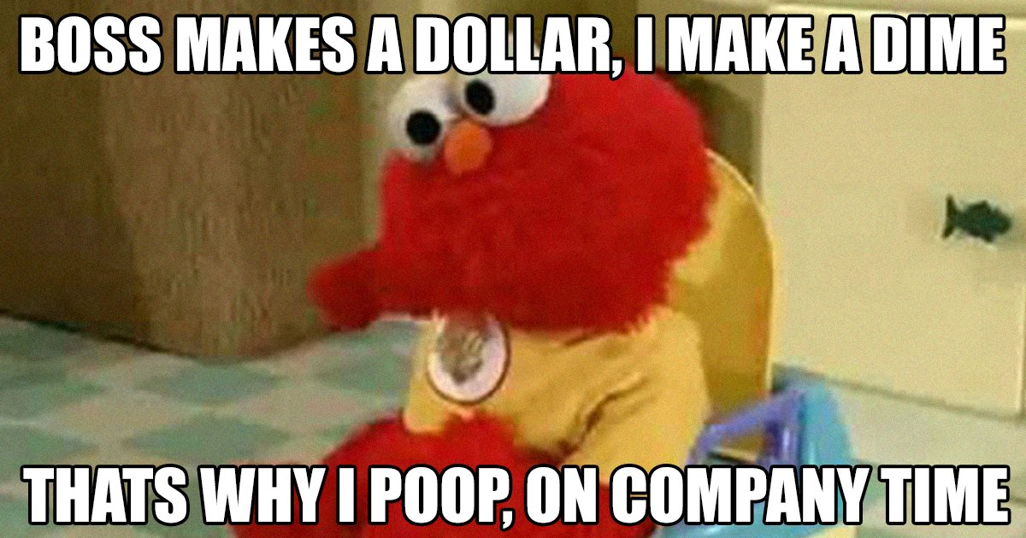
Most Pooped on
Runner Up
  Tom (1846.92 points against)
Winner
  Dan (1858.62 points against)

Slide 8
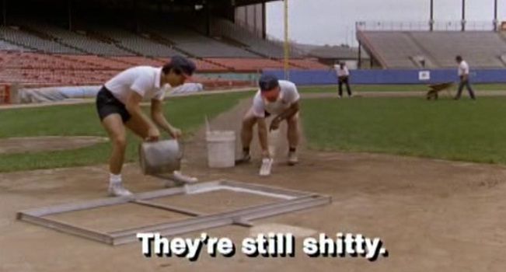
Shittiest
Runner Up
  Dan (1561.04)
Winner
  Neal (1550.98 points)
  3rd (12th?) year in a row

Slide 9

Creamed Corn Award (Cream of the Crop)
Runner Up
  Rob (1985.6 Points)
Winner
  Chris (1933.54 Points)

Slide 10

Bridesmaid
Winner
  Chris (again)
Runner up
  N/a – Kevin gave up before the second week of the championship started

Slide 11

Going for it Award
  Tom
    Gave up a ton of first round picks for Chase and Lamar but missed out on the playoffs anyway

Slide 12

Least Improved
Runner Up: Rich
  Was hot early but wound up selling at the deadline
Winner: Carbs
  Went from league to a combined 5-9 record selling assets along the way

Slide 13

Most Improved
Runner Up: Adam
  Finally cracked back into the playoffs but couldn’t bring home an elusive championship
Winner: Kevin
  Back in the playoffs and this time instead of cutting assets mid-season he cut them mid-championship game

Slide 14

Best Couple
Dan and “Talk Later”

Slide 15

Worst Couple
Winner: Rob and Sunday nights

Slide 16
Draft – August 27th
August 27th
Yes, Rob – it’s a Sunday
Let’s be real – probably around 6

Slide 17
PRE TOURNAMENT LOTTERY ODDS
10TH PLACE: 6 ENTRIES - DAN
9TH PLACE: 5 ENTRIES - NEAL
8TH PLACE: 4 ENTRIES - CARBS
7TH PLACE: 3 ENTRIES - TOM
6TH PLACE: 2 ENTRIES - RICH
5TH PLACE: 1 ENTRY - CHRIS

Slide 18
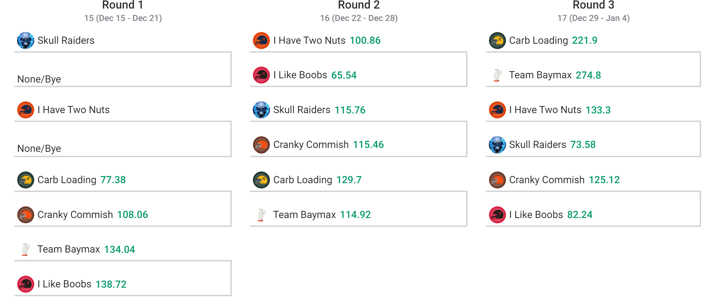
Toilet Bowl

Slide 19
TOURNAMENT LOTTERY ENTRIES
WINNER: NEAL - 6 ENTRIES
RUNNER UP: DAN - 5 ENTRIES
3RD PLACE: TOM - 4 ENTRIES
4TH PLACE: RICH - 3 ENTRIES
5TH PLACE: CHRIS - 2 ENTRIES
6TH PLACE: CARBS - 1 ENTRY

Slide 20
TOTAL LOTTERY ENTRIES
NEAL - 11 ENTRIES
DAN - 11 ENTRIES
TOM - 7 ENTRIES
CARBS - 5 ENTRIES
RICH – 5 ENTRIES
CHRIS - 3 ENTRIES

Slide 21
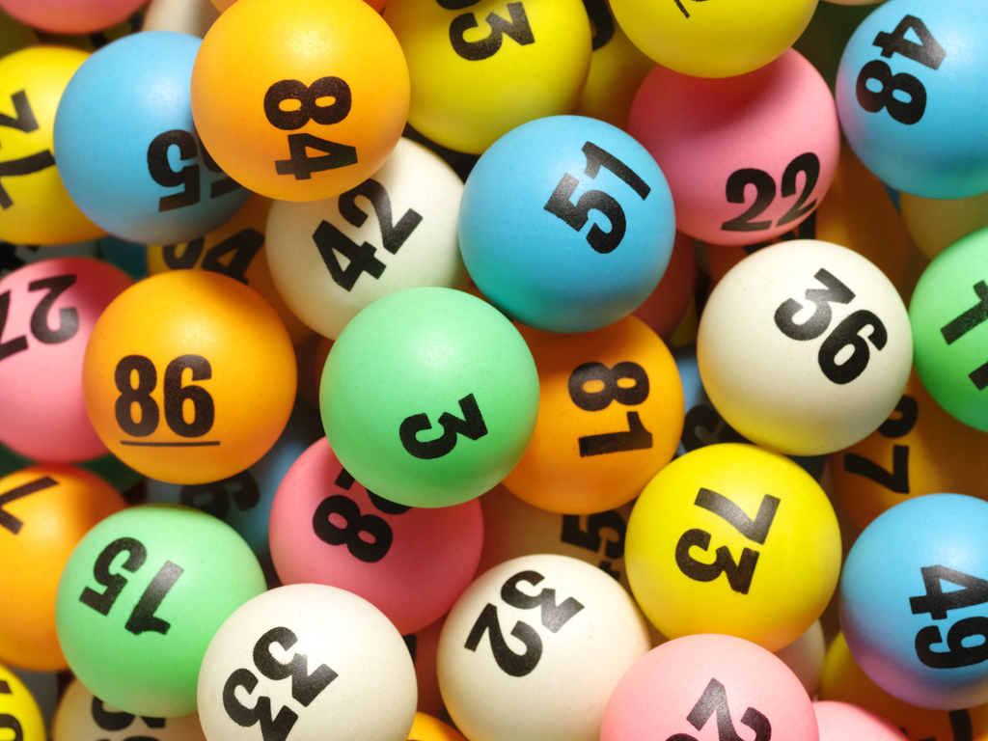
DRAFT LOTTERY

Slide 22

Rules Talk
Notes from last years Draft:
  Buying and amnesty
  Increasing the cap over time on a schedule
  Buying extra contract years

Slide 23

Open Discussion/Rage Quitting

