Slide 1
2021 Awards & Lottery

Slide 2

Ivan Reitman (1949 – 2022)
He came, he saw, he kicked it’s ass

Slide 3
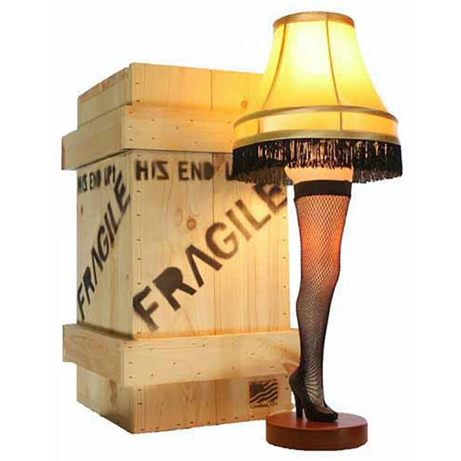
Leg Lamp Champions
2009: Kevin (Bad New Bears)
2010: Pat (Team Pokeher)
2011: Tom (Cleveland Curse)
2012: Pat (Team Pokeher)
2013: Kevin (My Left Nut)
2014: Matt (Team Weigand)
2015: Pat (Team Pokeher)
2016: Chris (Team Baymax)
2017: Tom O’Malley (Cranky Commish)
2018: Tom O’Malley (Cranky Commish)
2019: Tom O’Malley (Cranky Commish)
2020: Tom O’Malley (Cranky Commish)
2021: Carbs (Carb Loading)

Slide 4

Leg Lamp Champions
Titles:
  Tom – 5
  Pat – 3
  Kevin – 2
  Matt – 1
  Chris – 1
  Carbs - 1
No Titles:
  Adam
  Dan
  Neal
  Rich
  Rob

Slide 5

Awards

Slide 6

Champion
Carb Loading
- Leg Lamp Virgin!

Slide 7
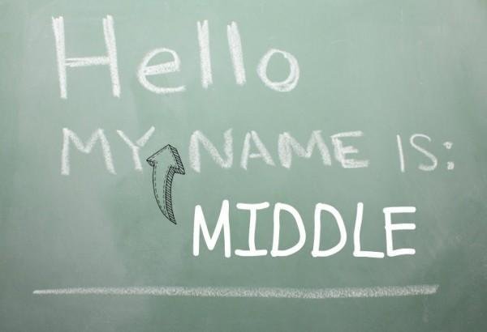
The Adam Dishong Award (Middler)
Adam
  Nothing else to say here
  2nd straight win in this category
  In reality, probably the 12th straight win
No Runner up

Slide 8
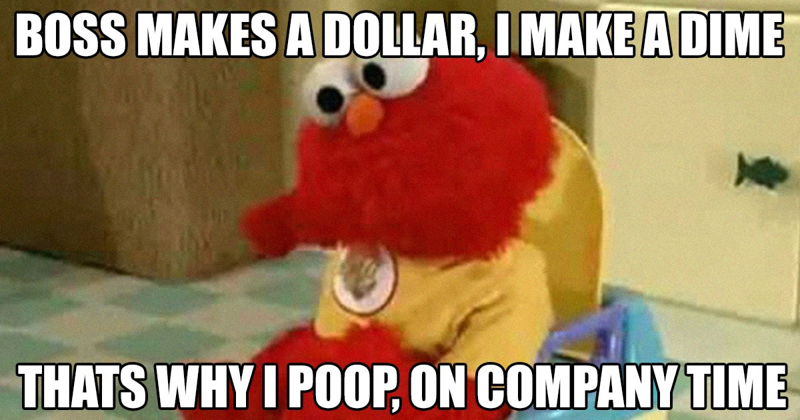
Most Pooped on
Runner Up
  Rich (1935.56 points against)
Winner
  Adam (1966.02 points against)

Slide 9
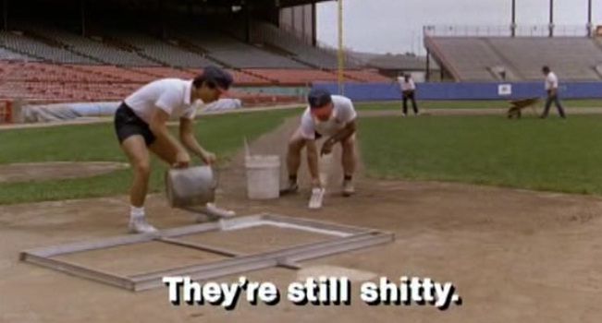
Shittiest
Runner Up
  No one – second worst team scored 451.14 points more than than the “winner”
Winner
  Neal (1367.46 points)
  2 (12th?) year in a row

Slide 10

Creamed Corn Award (Cream of the Crop)
Runner Up
  Rob (2063.44 Points)
Winner
  Chris (2082.88 Points)

Slide 11

Bridesmaid
Runner Up
  Chris
Winner
  Rob

Slide 12

Going for it Award
  Kevin
    Gave up massive assets for Lawrence, Taylor and Herbert but didn’t quite convert

Slide 13

Least Improved
Runner Up: Dan
  Had the leg lamp in his grasp last years but didn’t manage the playoffs this year
Winner: Commish
  Won last 4 years
  Couldn’t manage to make the playoffs and traded the 1st or 2nd pick for Diggs who was average

Slide 14

Most Improved
Runner Up: Rob
  Was 4-10 last year and had a real “Chase” for the championship this year
Winner: Carbs
  From the loser of the toilet bowl to the winner of the league

Slide 15
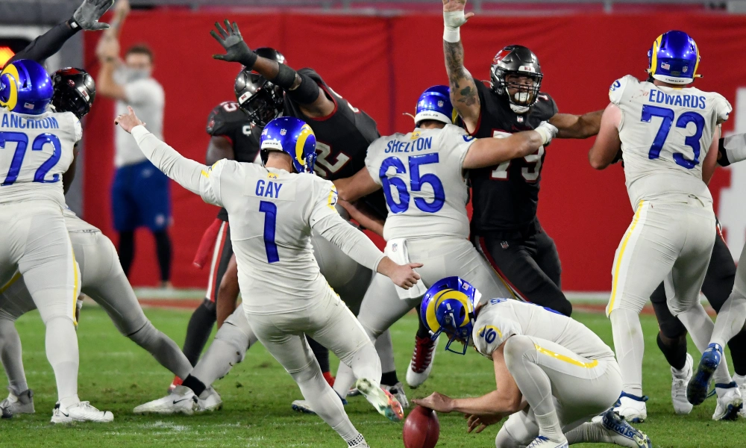
Best Couple
Pat and Kickers

Slide 16

Worst Couple
Runner up: Kickers and Neal
Winner: Rob and Kevin

Slide 17
Draft – August 28th
August 28th
Time TBD

Slide 18
PRE TOURNAMENT LOTTERY ODDS
10TH PLACE: 6 ENTRIES - NEAL
9TH PLACE: 5 ENTRIES - TOM
8TH PLACE: 4 ENTRIES - ADAM
7TH PLACE: 3 ENTRIES - DAN
6TH PLACE: 2 ENTRIES - PAT
5TH PLACE: 1 ENTRY - RICH

Slide 19
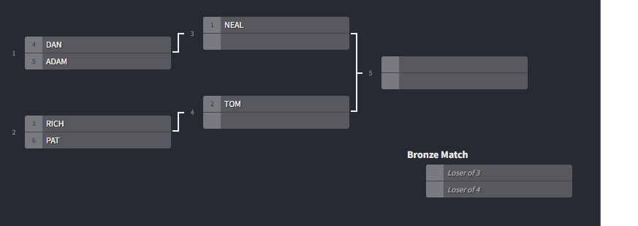

TOILET BOWL BRACKET
ADAM
ADAM
PAT
PAT
RICH
NEAL
DAN
TOM

Slide 20
TOURNAMENT LOTTERY ENTRIES
WINNER: ADAM - 6 ENTRIES
RUNNER UP: PAT - 5 ENTRIES
3RD PLACE: TOM - 4 ENTRIES
4TH PLACE: NEAL - 3 ENTRIES
5TH PLACE: RICH - 2 ENTRIES
6TH PLACE: DAN - 1 ENTRY

Slide 21
TOTAL LOTTERY ENTRIES
10TH PLACE: NEAL - 9 ENTRIES
9TH PLACE: TOM - 9 ENTRIES
8TH PLACE: ADAM - 10 ENTRIES
7TH PLACE: DAN - 4 ENTRIES
6TH PLACE: PAT - 7 ENTRIES
5TH PLACE: RICH - 3 ENTRIES

Slide 22
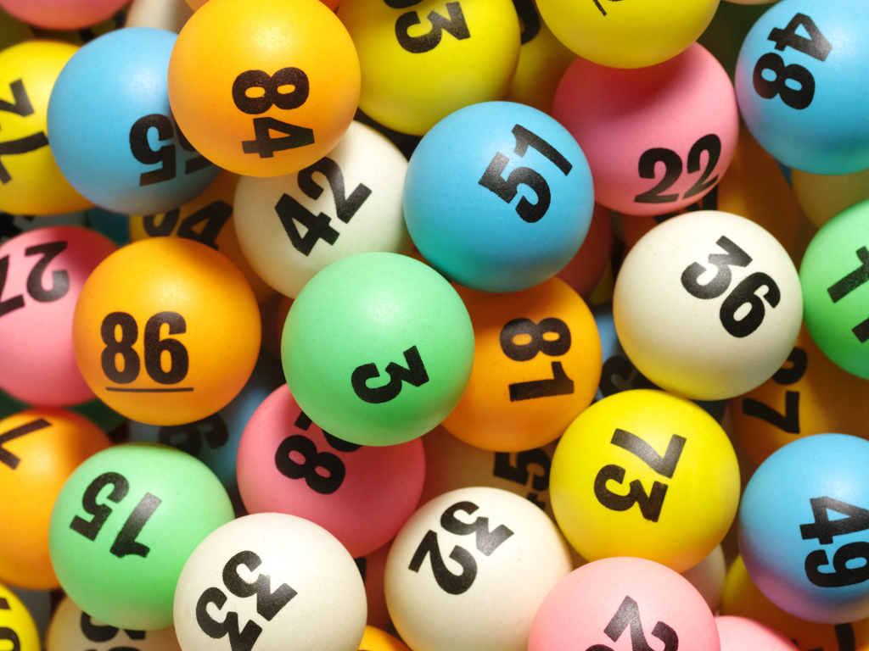
DRAFT LOTTERY

Slide 23

Rules Talk

Slide 24

Open Discussion/Rage Quitting

